Slide 1
Adversarial Search
Md Mehrab Hossain Opi
CSE 4109: Artificial Intelligence

Slide 2
Adversarial Search
Adversarial Search refers to a type of search algorithm used in multi-agent environments, where agents (players) compete against each other.
Unlike simple search algorithms that assume a single agent optimizing for one goal, adversarial search considers an opponent who tries to hinder the agent’s success.

Slide 3
Tic-Tac-Toe Game
🎮 Tic-Tac-Toe Rules
Players:
Two players: X and O
X always goes first
Board:
A 3 × 3 grid
Turns:
Players alternate placing their mark (X or O) on an empty square.
Winning Condition:
First player to get 3 in a row (horizontal, vertical, or diagonal) wins.
Draw Condition:
If all 9 squares are filled and no winner, the game ends in a draw.
X | X | O
O | X
O |  | X

Slide 4
Tic-Tac-Toe Game
Now consider two agents playing Tic-Tac-Toe.
Both are trying to win the game.
How does one agent decide its next move?
In traditional search, we only thought about finding a path or solution.
But in games, the other player is also making moves to stop us.
So, we must anticipate the opponent’s actions when deciding.
This need to plan against an opponent leads to Adversarial Search.
X | X | O
O | X
O |  | X

Slide 5
Tic-Tac-Toe Game
Computer doesn’t understand the notion of winning or losing.
It only understands numeric value.
Concept of bigger and smaller.
So, what we will try to do is give each possible outcome a number.
How many outcomes are possible?
X | X | O
O | X
O |  | X

Slide 6
Tic-Tac-Toe Game
O | X | X
O | O
O | X | X
X | X | O
O | X | X
X | O | O
X | X | O
O | X
O |  | X
-1
0
1

Slide 7
Tic-Tac-Toe Game
Player X always try to get maximum score possible.
Win = 1.
If can’t win draw = 0.
Player O always try to get the minimum score possible.
Win = -1, draw = 0.
O | X | X
O | O
O | X | X
X | X | O
O | X | X
X | O | O
X | X | O
O | X
O |  | X
-1
0
1

Slide 8
Tic-Tac-Toe Game
We will call X the MAX player.
And O will be called the MIN player.
O | X | X
O | O
O | X | X
X | X | O
O | X | X
X | O | O
X | X | O
O | X
O |  | X
-1
0
1

Slide 9
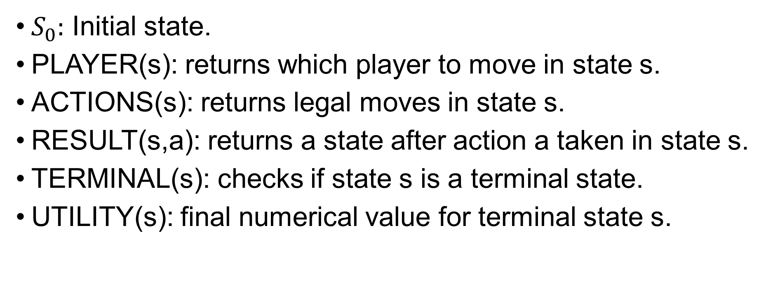
Game Definition
$S_{0}:$ Initial state.
PLAYER(s): returns which player to move in state s.
ACTIONS(s): returns legal moves in state s.
RESULT(s,a): returns a state after action a taken in state s.
TERMINAL(s): checks if state s is a terminal state.
UTILITY(s): final numerical value for terminal state s.

Slide 10
Initial State

Slide 11
PLAYER(s)
PLAYER( ) = X
PLAYER( ) = O
 | X

Slide 12
ACTIONS(s)
ACTIONS( ) = { , }
 | X | O
O | X | X
X |  | O
O
 | O

Slide 13
RESULTS(s, a)
RESULT( , ) =
 | X | O
O | X | X
X |  | O
O | X | O
O | X | X
X |  | O
O

Slide 14
TERMINAL(s)
TERMINAL( ) = false
TERMINAL( ) = true
 | X | O
O | X | X
X |  | O
X | X | O
O | X | X
X | O | O

Slide 15
UTILITY(s)
UTILITY( ) = -1
UTILITY( ) = 1
O | X | X
O | O
O | X | X
X | X | O
O | X
O |  | X

Slide 16
UTILITY(s)
UTLITY( ) = ?
 | X | O
O | X | X
X |  | O
This is where the Minimax algorithm comes in.

Slide 17
UTILITY(s)
 | X | O
O | X | X
X |  | O
PLAYER(s) = O
Min-Value: 0
O | X | O
O | X | X
X |  | O
 | X | O
O | X | X
X | O | O
PLAYER(s) = X
Max-Value: 0
Max-Value: 1
O | X | O
O | X | X
X | X | O
X | X | O
O | X | X
X | O | O
Value: 1
Value: 0

Slide 18
UTILITY(s)
 | X | O
O | X
X |  | O
 | X | O
O | X | X
X |  | O
X | X | O
O | X
X |  | O
 | X | O
O | X
X | X | O
O | X | O
O | X | X
X |  | O
 | X | O
O | X | X
X | O | O
X | X | O
O | X | O
X |  | O
X | X | O
O | X
X | O | O
O | X | O
O | X | X
X | X | O
X | X | O
O | X | X
X | O | O
X | X | O
O | X | X
X | O | O

Slide 19
Minimax Algorithm
function MAX-VALUE(state) returns a utility value
if TERMINAL-TEST(state) then
return UTILITY(state)
v ←−∞
for each a in ACTIONS(state) do
v ←MAX(v,MIN-VALUE(RESULT(s, a)))
return v

Slide 20
Minimax Algorithm
function MIN-VALUE(state) returns a utility value
if TERMINAL-TEST(state) then
return UTILITY(state)
v ←∞
for each a in ACTIONS(state) do
v ←MIN(v,MAX-VALUE(RESULT(s, a)))
return v

Slide 21
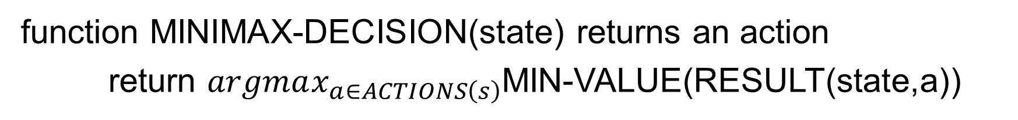
Minimax Algorithm
function MINIMAX-DECISION(state) returns an action
return $argmax_{a∈ACTIONS\left(s\right)}$MIN-VALUE(RESULT(state,a))
Assuming the player wants to minimize the utility value.

Slide 22
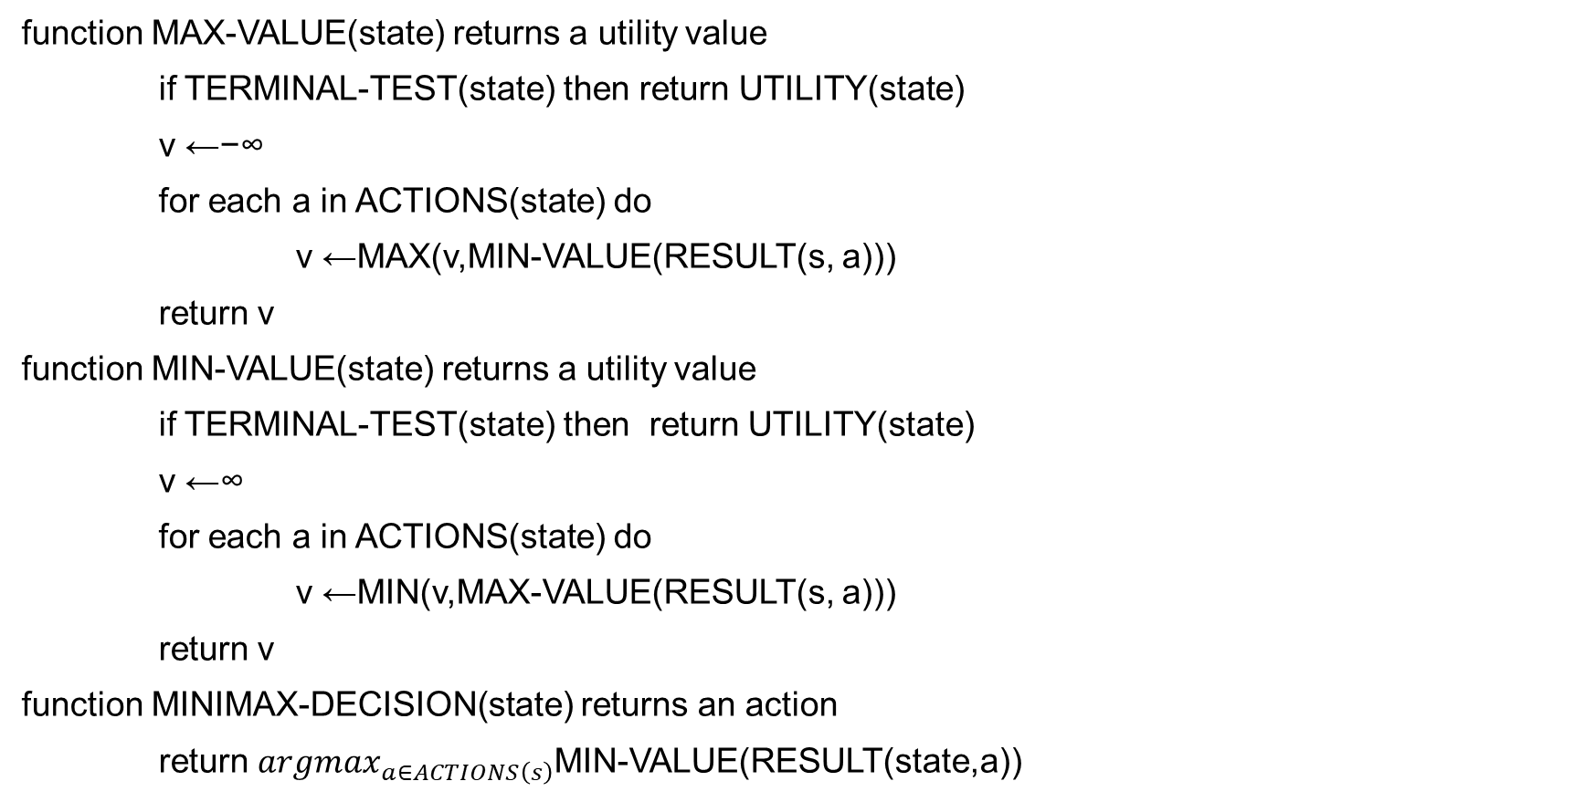
Minimax Algorithm
function MAX-VALUE(state) returns a utility value
if TERMINAL-TEST(state) then return UTILITY(state)
v ←−∞
for each a in ACTIONS(state) do
v ←MAX(v,MIN-VALUE(RESULT(s, a)))
return v
function MIN-VALUE(state) returns a utility value
if TERMINAL-TEST(state) then return UTILITY(state)
v ←∞
for each a in ACTIONS(state) do
v ←MIN(v,MAX-VALUE(RESULT(s, a)))
return v
function MINIMAX-DECISION(state) returns an action
return $argmax_{a∈ACTIONS\left(s\right)}$MIN-VALUE(RESULT(state,a))

Slide 23
Alpha-Beta Pruning
Number of game states that needs to be examined is exponential in the depth of the tree.
We can’t remove the exponent part but can effectively cut it in half.
The trick is, it is possible to compute the correct minimax decision without looking at every node in the game tree.

Slide 24
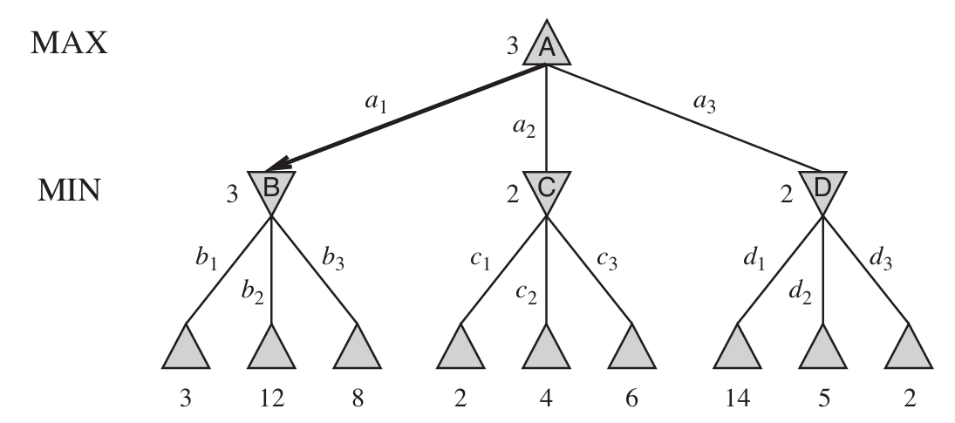
Alpha-Beta Pruning

Slide 25
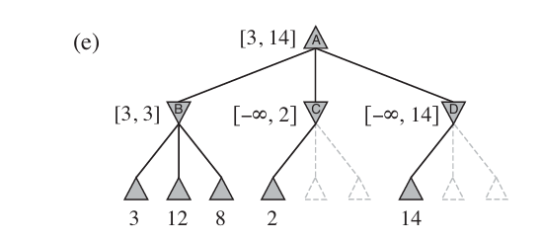
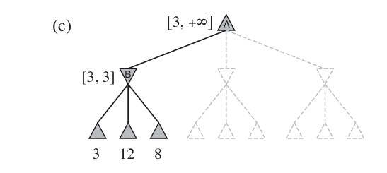
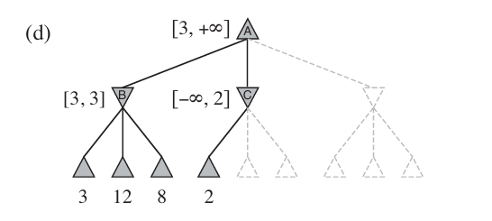
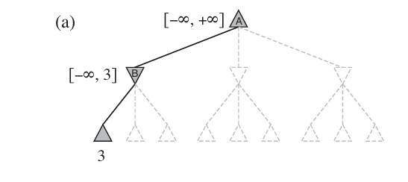
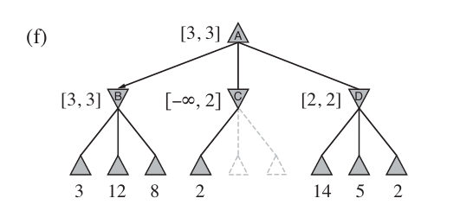
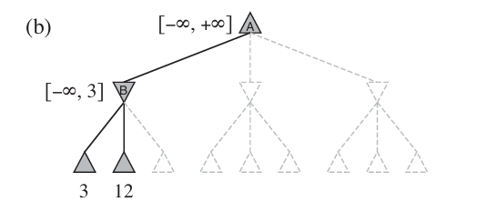
Alpha-Beta Pruning

Slide 26
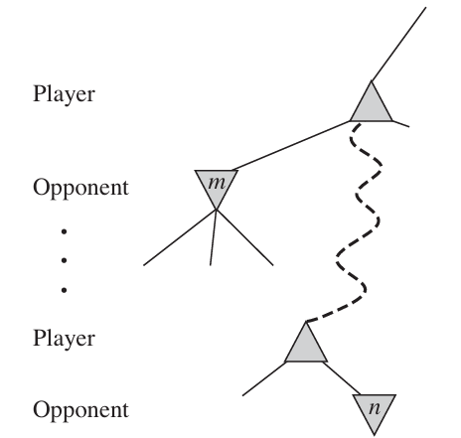
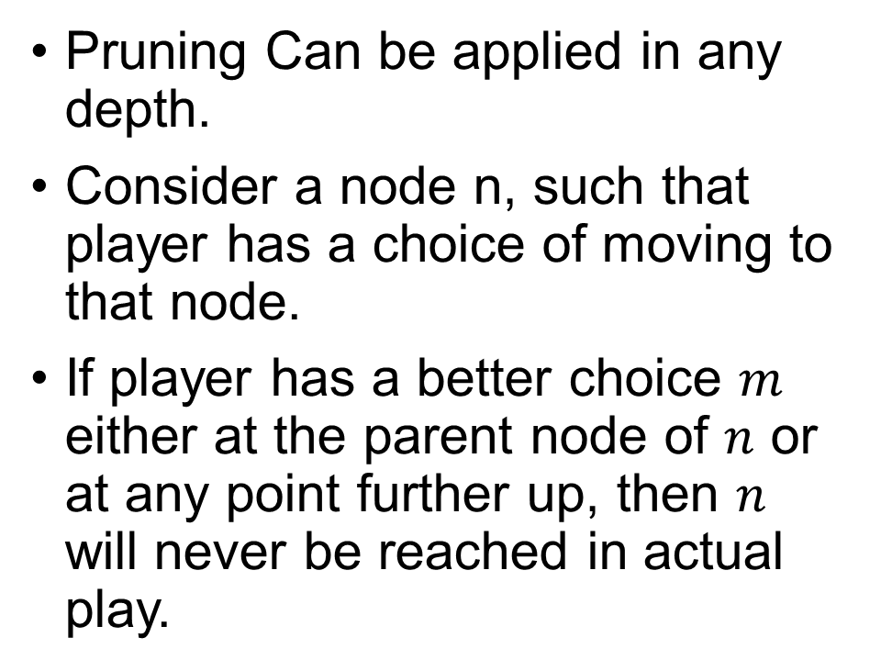
Alpha-Beta Pruning
Pruning Can be applied in any depth.
Consider a node n, such that player has a choice of moving to that node.
If player has a better choice $m$ either at the parent node of $n$ or at any point further up, then $n$ will never be reached in actual play.

Slide 27
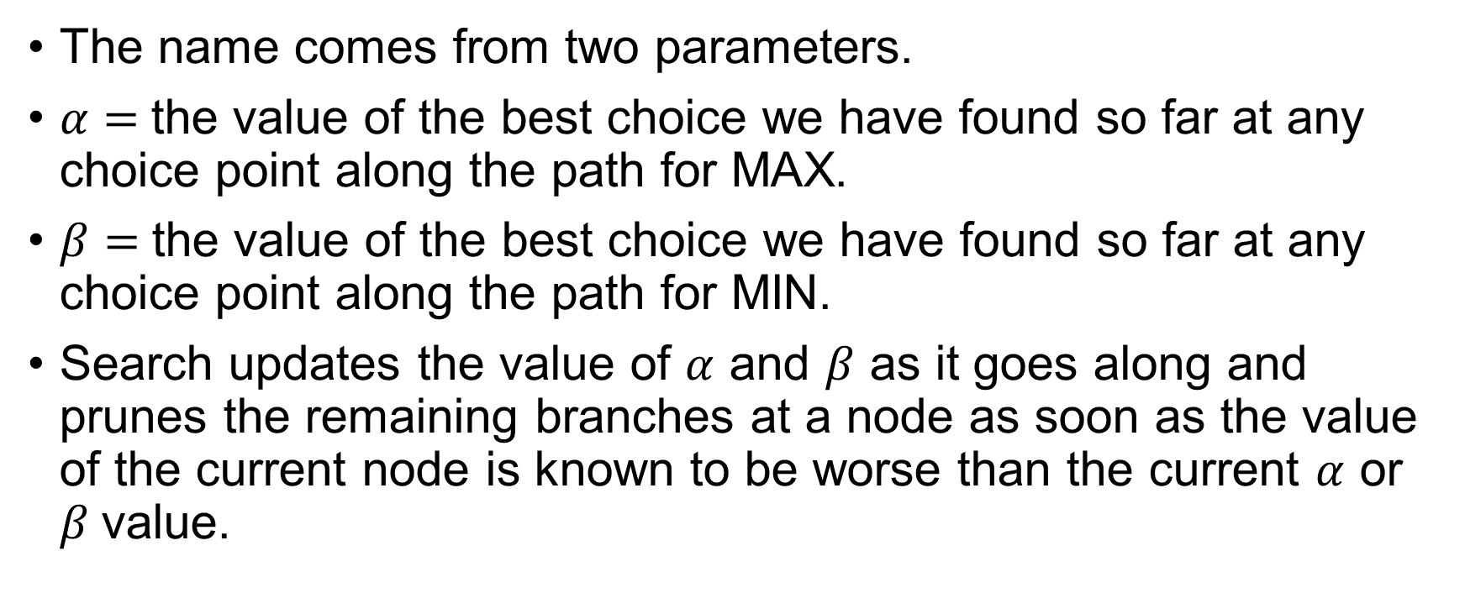
Alpha-Beta Pruning
The name comes from two parameters.
$α=$the value of the best choice we have found so far at any choice point along the path for MAX.
$β=$the value of the best choice we have found so far at any choice point along the path for MIN.
Search updates the value of $α$ and $β$ as it goes along and prunes the remaining branches at a node as soon as the value of the current node is known to be worse than the current $α$ or $β$value.

Slide 28
Alpha-Beta Pruning
function ALPHA-BETA-SEARCH(state) returns an action
v ←MAX-VALUE(state,−∞,+∞)
return the action in ACTIONS(state) with value v
function MAX-VALUE(state,α,β) returns a utility value
if TERMINAL-TEST(state) then
return UTILITY(state)
v ←−∞
for each a in ACTIONS(state) do
v ←MAX(v, MIN-VALUE(RESULT(s, a), α, β))
if v ≥ β then return v
α←MAX(α,v)
return v
function MIN-VALUE(state,α,β) returns a utility value
if TERMINAL-TEST(state) then
return UTILITY(state)
v ←+∞
for each a in ACTIONS(state) do
v ←MIN(v, MAX-VALUE(RESULT(s, a), α, β))
if v ≤ α then return v
β←MIN(β, v)
return v

Slide 29
Imperfect Real-Time Decision
Minimax has to search all the way to terminal state.
Even for pruning.
Depth is usually not practical.
Instead of going to terminal state we will cut off the search earlier.
How can we assign value to a node without seeing a terminal state?

Slide 30
Imperfect Real-Time Decision
We will apply a heuristic evaluation function to states in the search.
The UTILITY function will be replaced.
Also, instead of TERMINAL function we will use a cutoff test.

Slide 31
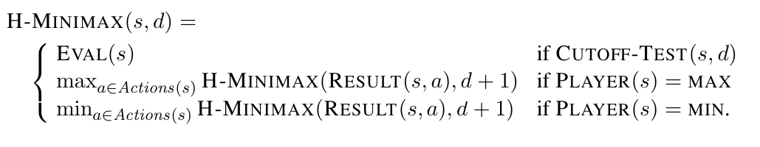
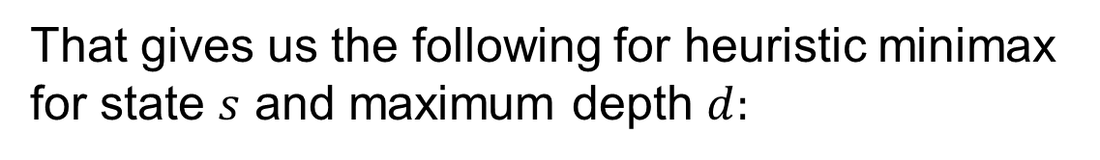
Imperfect Real-Time Decision
That gives us the following for heuristic minimax
for state $s$ and maximum depth $d:$

Slide 32
Evaluation Function
An Evaluation function returns an estimate of the expected utility of the game from a given position.
The performance of a game playing program depends on the quality of its evaluation function.
How exactly do we design good evaluation functions?

Slide 33
Evaluation Function
The function should order the terminal states in the same way as the true utility function.
State that wins must evaluate better than draws.
The computation must not take too long.
For non-terminal states, the evaluation function should be strongly correlated with the actual chances of winning.

Slide 34
Evaluation Function
Most evaluation function work by calculating various features of the state.
Features define different categories or equivalence class of states.
An expected value is determined for each category.

Slide 35
Evaluation Function
In practice, this kind of analysis requires too many categories and hence too much experience to estimate all the probabilities of winning.
Most functions compute separate numerical contribution from each feature and then combine them to find total value.

Slide 36
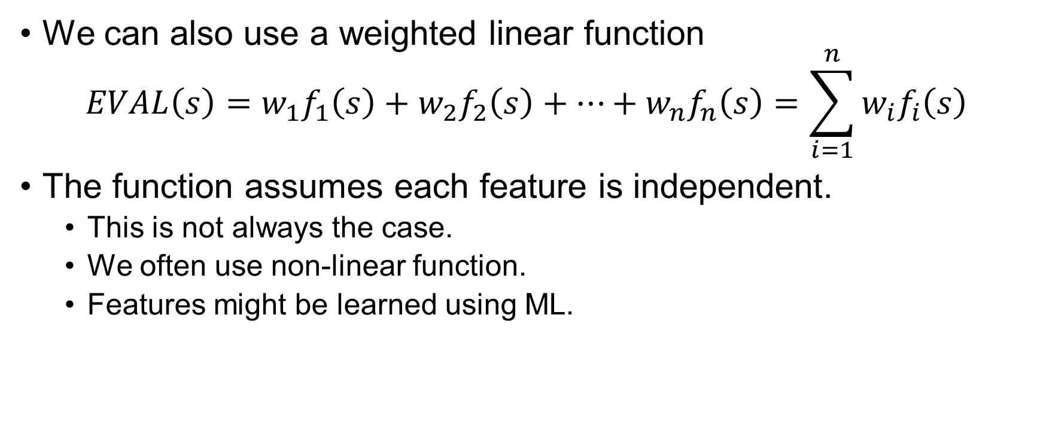
Evaluation Function
We can also use a weighted linear function
$$EVAL\left(s\right)=w_{1}f_{1}\left(s\right)+w_{2}f_{2}\left(s\right)+…+w_{n}f_{n}\left(s\right)=\sum_{i=1}^{n}{w_{i}f_{i}\left(s\right)}$$
The function assumes each feature is independent.
This is not always the case.
We often use non-linear function.
Features might be learned using ML.
Notes:
Chess Playing example.

Slide 37
Cutting of Search
Self Study. (Section 5.4.2)

Slide 38
Thank You.

